Slide 1
Key DRM Report
Presented by Billy
Last updated: Nov 26th, 2023

Slide 2
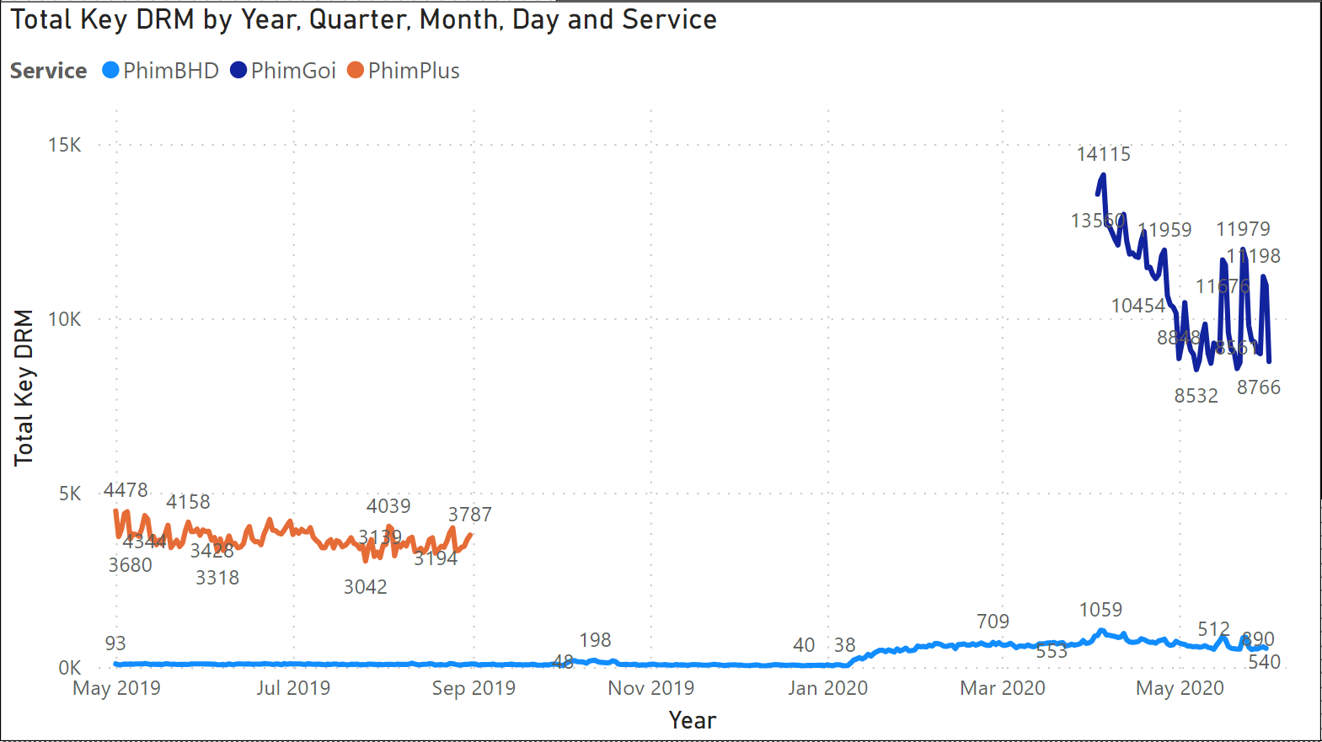
Overview
Campaign was from May 1st 2019 – Jun 1st 2020 ( 13 months)
PhimPlus was launched from May 2019 – Sep 2019 ( 5 months)
PhimGoi was launched from Apr 2020 – Jun 2020 (3 months)
Phim BHD was launched during the whole campaign.

Slide 3
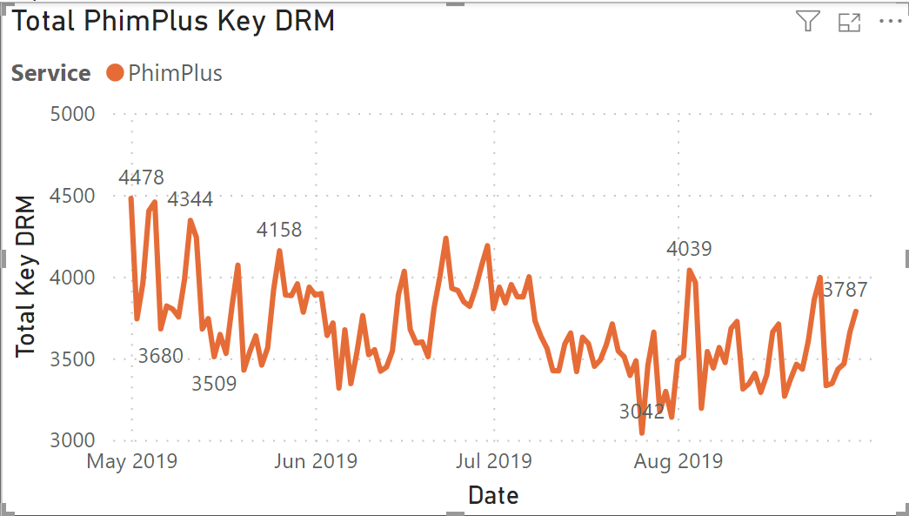
PhimPlus
May 2019 – Sep 2019
High peak fell on Friday, Saturday and Sunday.
People prefer watching Movies in the weekend.
Total Keys between 3042 – 4478

Slide 4
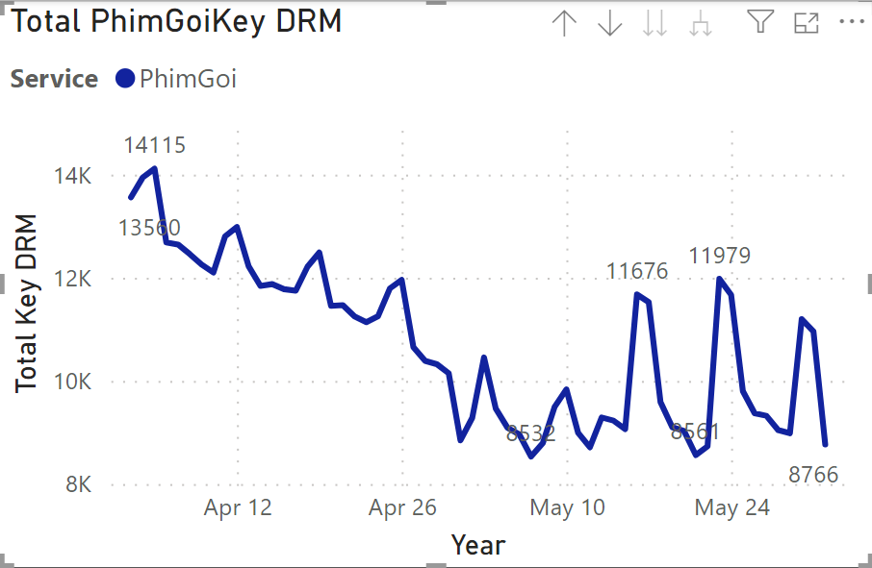
Phim Goi
Apr 2020 – May 2020
During Covid, people stayed at home and had more time on Movies.
High peaks fell on Friday, Saturday and Sunday.
Total Keys between 8532 – 14115, as triple as PhimPlus during Non-Covid time.

Slide 5
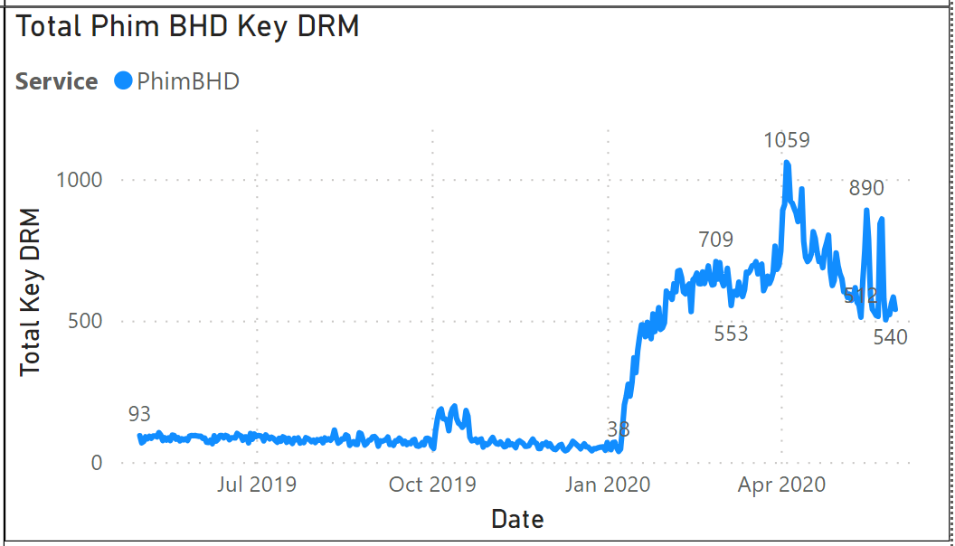
Phim BHD
Had a stable views.
Peak started in Mar 2020 – Covid time.
During non-covid, total Key DRM between 38-93.
During covid, total Key DRM between 553 – 1059, which is 5-10 times more.

